Slide 1
LAB EXPERIENCE
6G Connected Autonomous Vehicles
Usevalad Milseheuski

Slide 3
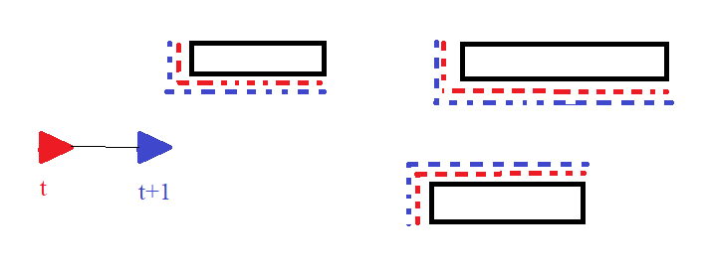
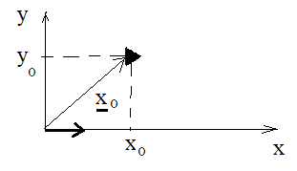

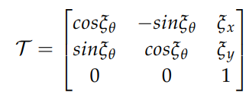

Problem: Given two consecutive scans find rigid body transformation
X₀ = [X₀ , X₀ , φ₀] - pose
Roto-translation matrix

Slide 4


The scan matching problem can be described in a probabilistic framework using Bayes rule
u - motion (how you move between the poses);
m - scenario (environment)
z - measurement (scan)
Second multiplier is difficult to be evaluated, since m can not be measured completely. Therefore, we assume
Not knowing the real m, we can acquire it using SLAM by mapping the previous scan. We can estimate the needed shifts and rotation by correlating the previous scan with the next one.

Slide 5

Rigid body transformation
Find the parameters which maximize the correlation between two poses

Slide 6

Steps made
Transformation of GPS data from latitude and longtitude to Cartesian using “deg2utm” function. In addition, since the heading is not provided it is possible to estimate (and then unwrap) it the following way:

Slide 7
Steps made
2) Since the sampling rates of GPS and lidar are different, (T_lidar = 0.1154 s; T_gps = 0.1 s), linear interpolation was performed to estimate GPS samples at the corresponding lidar’s positions using “interp1” function

Slide 8
Steps made
3) Preprocessing of scans firstly required a)conversion to polar coordinates to cartesian and b) shift wrt. the origin using GPS data, therefore having the data in the global system

Slide 9
Steps made
4) Using brute force approach, we searched for the proper parameters (shifts and a rotation) in order to maximize the correlation. Using “diff” function it was possible to get the search region. For correlation, each frame is converted into a binary “picture”, which then matched with the next one. For convenience, mapping is done in local system, which is then shifted to the global one

